Slide 1
Work with Docker
Practical

Slide 2
How to Push Docker Image to Docker Hub
To push a Docker image to Docker Hub, you can follow these steps:
Create a Docker Hub Account:
To proceed, visit https://hub.docker.com and register for a Docker Hub account if you don’t already have one.
Creating an account will grant you a username and password that you can use for authentication purposes.

Slide 3
2. Tag the Docker Image: Before performing a Docker Push, it’s essential to ensure that your Docker image is properly tagged. You can assign a tag to an existing image using the following command:
docker tag <image-id> <docker-hub-username>/<image-name>:<tag>
Replace `<image-id>` with the ID or name of your local Docker image. `<docker-hub-username>` should be your Docker Hub username, `<image-name>` is the name you want to give to your image, and `<tag>` represents a specific version or label for the image.

Slide 4
3. Log in to Docker Hub: Use the following command to log in to your Docker Hub account from the command line:
docker login
You will be prompted to enter your Docker Hub username and password.
4. Push the Docker Image: Once logged in, push the tagged Docker image to Docker Hub using the command:
docker push <docker-hub-username>/<image-name>:<tag>
Replace `<docker-hub-username>`, `<image-name>`, and `<tag>` with the respective values you used

Slide 5
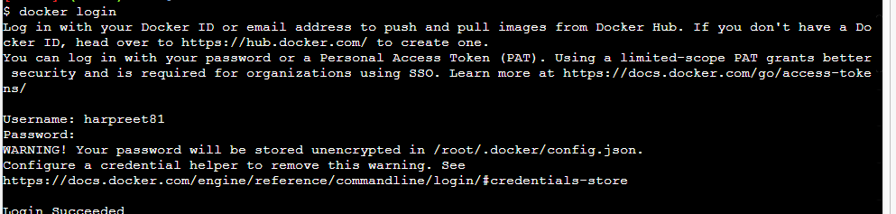
1. firstly find the images that you want to push in respository
2. Then use the login command to get login in docker hub as:

Slide 6
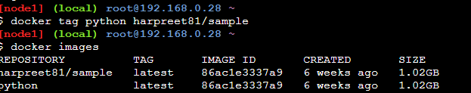
3. Then use tag command to give tag name to image :
Docker tag <image name> <tag name>

Slide 7
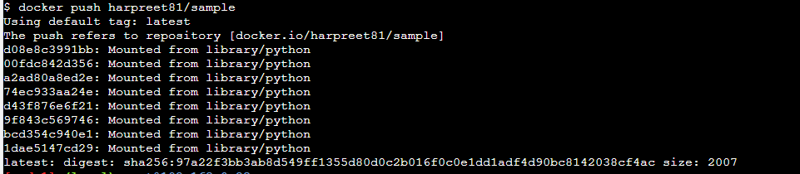
4. use push command
Docker push

Slide 8
Ex#2(Practice Question):
Update the alpine container and push on to docker hub

Slide 9
1. docker run –d –it –name a1 alpine
2. docker exec –it a1 bash
3. #: apk update
# apk add apache2
# apk add php
# exit
4. docker commit a1 harpreet81/alpine-a:v1
5. docker login
6. docker push harpreet81/alpine-a:v1

Slide 10
To Create Docker Image by Docker file
Dockerfile:
Dockerfile is a simple text file that consists of instructions to build Docker images.
Mentioned below is the syntax of a Dockerfile:
Syntax
# comments
command argument argument1...
Example
# Print "Get Certified. Get Ahead"
Run echo "Get Certified. Get Ahead"

Slide 11
The specific commands you can use in a dockerfile are
FROM, PULL, RUN, and CMD
FROM - Creates a layer from the ubuntu:18.04
PULL - Adds files from your Docker repository
RUN - Builds your container
CMD - Specifies what command to run within the container

Slide 12
ENTRYPOINT allows specifying a command along with the parameters
ADD command helps in copying data into a Docker image
ADD /[source]/[destination]
ENV provides default values for variables that can be accessed within the container
ENV key value

Slide 13

Ex#1 : Create Ubuntu docker file

Slide 14
Ex#2: Create Java Docker file
$ mkdir java-docker
2. Create a Java File
Now create a Java file. Save this file as Hello.java file.
// Hello.java
class Hello{
public static void main(String[] args){
System.out.println("This is java app \n by using Docker");
}
}
Save it inside the directory java-docker as hello.java

Slide 15
3. Create a Dockerfile
FROM java:8
COPY . /var/www/java
WORKDIR /var/www/java
RUN javac Hello.java
CMD ["java", "Hello"]
4. Build Docker Image
After creating Dockerfile, we are changing working directory.
$ cd java-docker-app

Slide 16
5. $ docker build -t java-app .
6. $ docker run java-app

Slide 17
FROM java:8
COPY . /var/www/java
WORKDIR /var/www/java
RUN javac Hello.java
CMD ["java", "Hello"]

Slide 18
Types of Storage
in
Docker

Slide 19
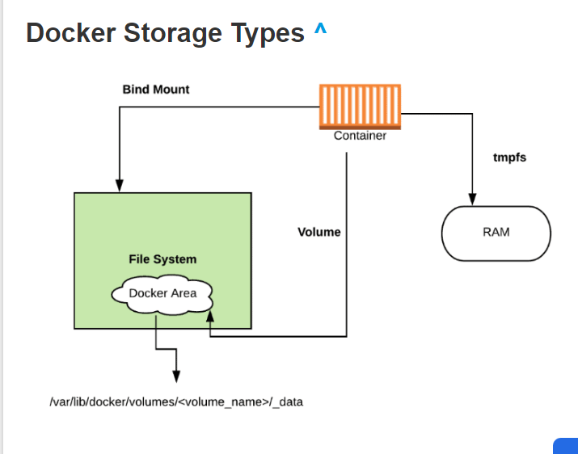

Slide 20
Docker storage distinguishes three storage types.
Two types are permanent: Docker volumes and bind Mounts
and the third way of writing data is tmpfs.
From the container perspective, it doesn’t know what sort of storage is in use.

Slide 21
The difference between these is, volumes have a dedicated filesystem on the host (/var/lib/ docker/volumes) and are directly controlled through the Docker CLI.
On the other hand, bind mounts use any available host filesystem.
Whereas tmfs, uses the host memory.

Slide 22
Docker Volume
Docker volume is the most commonly used technology for the permanent storage of container data.
Docker volume is managed by Docker itself and has a dedicated filesystem on the host, doesn’t depend upon the filesystem structure on the host.
Docker volumes are explicitly managed via the Docker command line and can be created alone or during container initialization. T
he command used is
docker volume create.

Slide 23
When stopping or deleting a container, Docker volume remains permanently stored.
The volumes are often manually deleted with the docker volume prune command.
Multiple containers can be connected to the same Docker volume.

Slide 24
Commands used for the Volumes
1. docker volume create
Used to Create a volume
2. docker volume inspect
Display detailed information on one or more volumes
3. docker volume ls
List volumes

Slide 25
4.docker volume prune
Remove all unused local volumes
5. docker volume rm
Remove one or more volumes

Slide 26
Some use cases for volumes include:
Sharing data among multiple running containers.
Volume is helpful if the Docker host is not guaranteed to have a given directory or file structure.
When you want to store your container’s data on a remote host or a cloud provider instead of storing locally.
Volumes are helpful if you need to back up, restore, or migrate data from one Docker host to another, volumes are a better choice

Slide 27
Docker Bind Mount
Docker bind mount is the second permanent storage option but with more limited options than Docker volume.
It can’t be managed via Docker CLI and is totally dependent on the availability of the filesystem of the host.
A host filesystem can be created when running a container. Bind mounts are a sort of superset of Volumes (named or unnamed).

Slide 28
tmpfs Mounts
tmpfs is a third storage option that is not permanent like Docker volume or bind mount.
The data is written directly on to the host’s memory and deleted when the container is stopped.
Very useful when it involves sensitive data that you simply don’t want to be permanent.

Slide 29
A really significant difference is that containers can’t share tmpfs space unless they’re running on Linux OS.
Two flags are used when creating tmpfs volume: tmpfs and mount.
Mount flag is newer and supports multiple options during containe startup.

Slide 30
Temporary filesystems are written to RAM (or to your swap file if RAM is filling up)
and not to the host or the container’s own filesystem layer at Docker.com: Docker tmpfs.

Slide 31
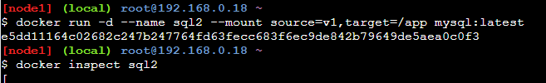

Slide 32
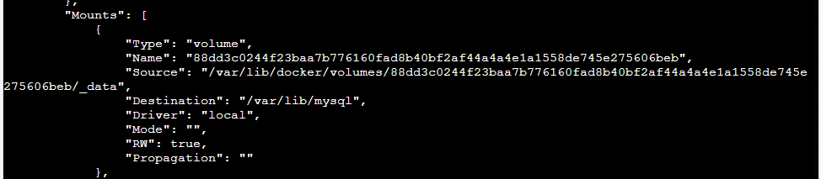

Slide 33
Ex#2:
We can manage volumes through the docker cli directly (unlike bind mounts)

Slide 34
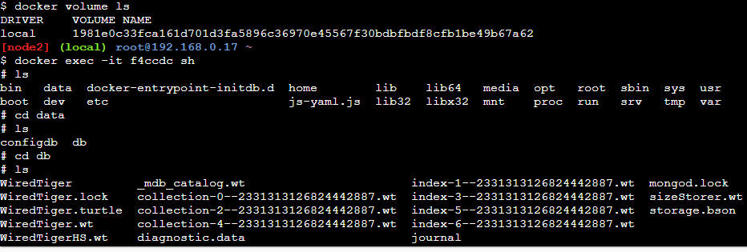

Slide 35
EX#3
echo "<h1>message from Host</h1>" > ./target/index.html
docker run -it --rm --name nginx -p 8080:80
-v "$(pwd)"/target:/usr/share/nginx/html nginx

